Slide 1
SWE30003 Software Architectures and Design
Lecture 6 Object Design (Part II) – Design Refinement / Better Design

Slide 2
Logistical matters
Weekly submissions – A & Q
Week 2: 104 & 101 out of 119;
Week 3: 101 & 98 out of 118;
Week 4: 102 & 101 out of 118;
Week 5: 98 & 98 out of 118;
Week 6: 88 & 84 out of 117;
Note that this is a hurdle requirement
No late submission
Assignment 2 spec:
Released …
Start as soon as released.

Slide 3
Question to Answer – week 5
In what way are objects, the artificial building blocks of a machine or software system, similar to a living, biological organism? What role do they play in helping us to understand and think about a problem?
Notes:
They all have identity and purpose,
Connect/interact with others,
Have state and behaviour;
Composable to form larger entities, eventually forming a “functioning whole”.

Slide 4
Principal References
Bernd Bruegge and Allen H. Dutoit, Object-oriented Software Engineering, Prentice Hall, 2001, Chapter 5.
Bertrand Meyer, Object-Oriented Software Construction (2nd Edition), Prentice Hall, 1997, Chapters 11, 23, 24.
Rebecca Wirfs-Brock, Brian Wilkerson and Lauren Wiener, Designing Object-Oriented Software, Prentice Hall, 1990, Chapter 5.
Arthur J. Riel, Object-Oriented Design Heuristics, Addison Wesley, 1996, various chapters.

Slide 5
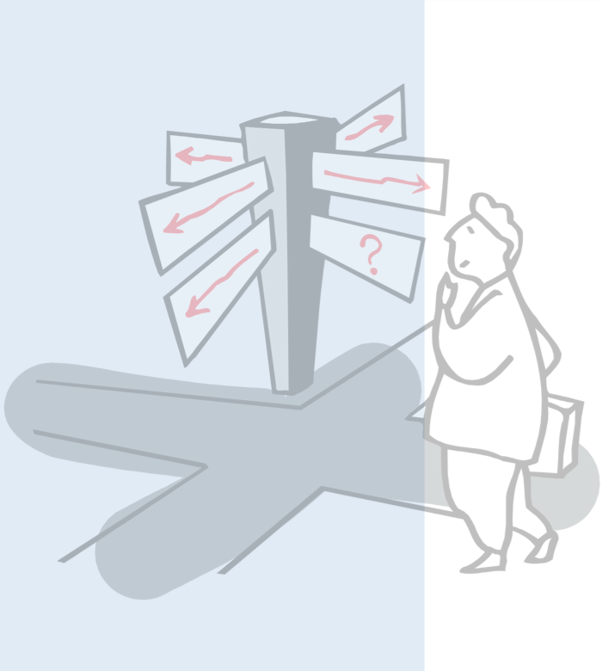
Roadmap
Recap Lecture 5
Building good class hierarchies
Types of inheritance
Heuristics for creating class hierarchies
Roles and Protocols
Associations and Aggregations
Design by Contract

Slide 6
Recap from Lecture 5
An application = a set of interacting objects
An object = an implementation of one or more roles
A role = a set of related responsibilities
A responsibility = an obligation to perform a task or know certain information
A collaboration = an interaction of objects or roles

Slide 7
Recap from Lecture 5 (cont.)
What are responsibilities?
the knowledge an object maintains and provides,
the actions it can perform.
Responsibilities represent the public services an object may provide to clients (but not the way in which those services may be implemented)
specify what an object does, not how it does it.
Do not describe the interface yet, only conceptual responsibilities.

Slide 8
Recap from Lecture 5 (cont.)
What are collaborations?
collaborations are client requests to servers needed to fulfill responsibilities, (here: both client & server are objects/classes)
collaborations reveal control and information flow
collaborations can uncover missing responsibilities,
analysis of communication patterns can reveal mis-assigned responsibilities.

Slide 9
Recap from Lecture 5 (cont.)
Try to evenly distribute system intelligence
avoid procedural centralization of responsibilities
keep responsibilities close to objects rather than their clients
Note: this is not always possible (or even desirable)!
State responsibilities as generally as possible
“draw yourself” vs. “draw a line/rectangle etc.”
leads to sharing
Keep behavior together with any related information
principle of encapsulation.

Slide 10
What we got…
A list of candidate classes
and some initial justification why they are needed
A list of responsibilities
and an initial allocation of responsibilities to classes
For each responsibility assigned to a class
a list of collaborators needed to fulfill this responsibility
Expanded domain model, extended with responsibilities and collaborations…

Slide 11
What next? … Refine the design!
Factor common responsibilities to build class hierarchies
Streamline collaborations between objects:
Is message traffic heavy in parts of the system?
Are there classes that collaborate with everybody?
Are there classes that collaborate with nobody?
Can we identify protocols and roles amongst the collaborations?
Can we identify contracts between collaboration objects?
Apply design heuristics and common sense to improve specific design aspects.
This may not always work… but let’s see!

Slide 12
Roadmap
Recap Lecture 5
Building good class hierarchies
Types of inheritance
Heuristics for creating class hierarchies
Roles and Protocols
Associations and Aggregations
Design by Contract

Slide 13

Object-Oriented Design Heuristics
Seminal work, describing app. 60 heuristics to improve object-oriented design and implementation
A selected few of the heuristics will be introduced in this lecture.

Slide 14
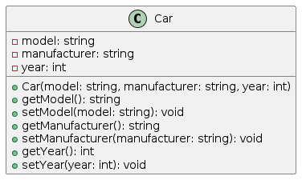
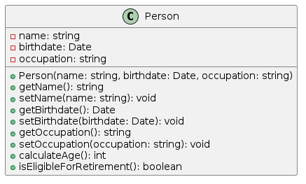
Heuristics for System Classes
Heuristic 2.8 (p. 19)
A class should capture one and only one key abstraction
Key abstraction = important concept of the domain model
If this is violated, we immediately reduce cohesion
Heuristic 2.9 (p. 20)
Keep related data and behaviour in one place
Otherwise, need to define (unnecessary) accessor methods and/or “data-holder” only classes, implying increased coupling

Slide 15
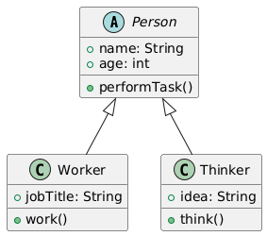
Heuristics for System Classes (cont.)
Heuristic 3.1 (p. 33)
Distribute system intelligence horizontally as uniformly as possible, that is, top-level classes of the system should share their work uniformly
One needs to think where the system objects are created!

Slide 16
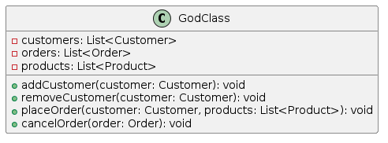
Heuristics for System Classes (cont.)
Heuristic 3.2 (p. 33)
Do not create god classes/objects in your system
God class implies many responsibilities, hence significant complexity, hence difficult to understand and maintain.
God classes are often prone to contain many defects!

Slide 17
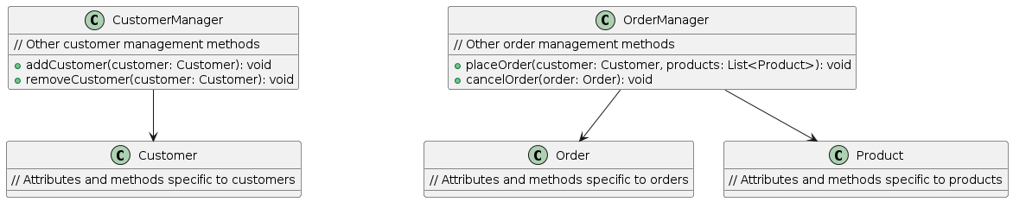

Slide 18
Roadmap
Recap Lecture 5
Building good class hierarchies
Types of inheritance
Heuristics for creating class hierarchies
Roles and Protocols
Associations and Aggregations
Design by Contract

Slide 19
Inheritance = Incremental Derivation
Notes:
I need to discuss here what inheritance ACTUALLY is -> incremental derivation: change some ‘behaviour’ and adding new ‘behaviour’…

Slide 20
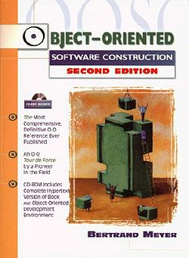
Object-Oriented Software Construction
Seminal book by Bertrand Meyer about foundations and practices of object-oriented design
Contains a number of principles for object design
Discusses “Design by Contract”

Slide 21
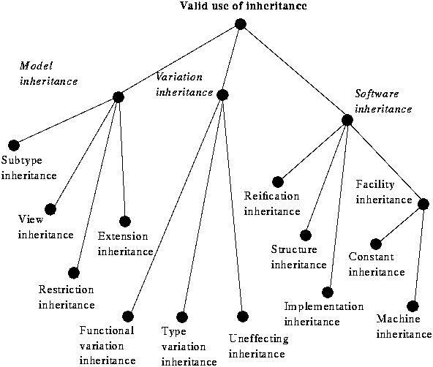
Taxonomy of Inheritance
Source: B. Meyer, Object-Oriented Software Construction, 1997

Slide 22
Taxonomy of Inheritance (cont.)
Model inheritance, reflecting “is-a” relations between abstractions in the model.
Software inheritance, expressing relations within the software itself rather than in the model.
Some of them are considered “bad practice”…
Derive a Stack from a List class
Variation inheritance - a special case that may pertain either to the software or to the model - serving to describe a class through its differences with another class.
(cf. http://archive.eiffel.com/doc/manuals/technology/oosc/inheritance-design)

Slide 23
Taxonomy of Inheritance (cont.)

Slide 24
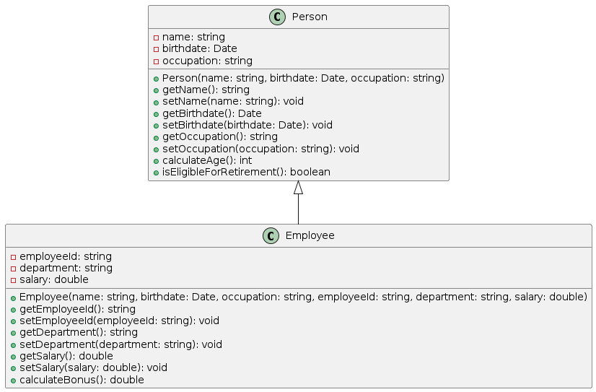
Heuristics for Inheritance
Heuristic 5.1 (p. 81)
Inheritance should be used only to model a specialization hierarchy
We will revisit this heuristics later on…
Never make explicit reference to a subclass!!

Slide 25
Heuristics for Inheritance
Heuristic 5.2 (p. 81)
Derived classes must have knowledge of their base class (by definition), but base classes should not know anything about their derived classes
Never make explicit reference to a subclass!!

Slide 26
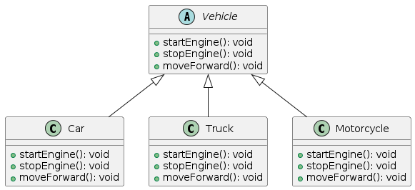
Abstract Classes
Abstract classes factor out common behavior shared by other classes (i.e. their subclasses)
group related classes with common responsibilities
introduce abstract parent classes to represent the group
“categories” are good candidates for abstract classes
Warning: beware of premature classification; your hierarchy will evolve!

Slide 27
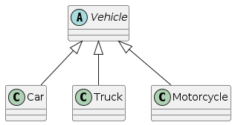
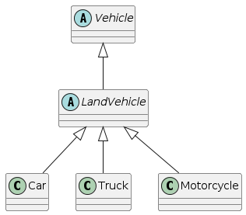
Heuristics for Abstract Classes
Heuristic 5.6 (p. 89)
All abstract classes must be base classes
No point having abstract classes that are not derived from!
Heuristic 5.7 (p.89)
All base classes should be abstract classes
In an inheritance tree, only leaf nodes should be concrete classes, all other nodes are abstract.
Note: there is often a perceived need to violate this!

Slide 28
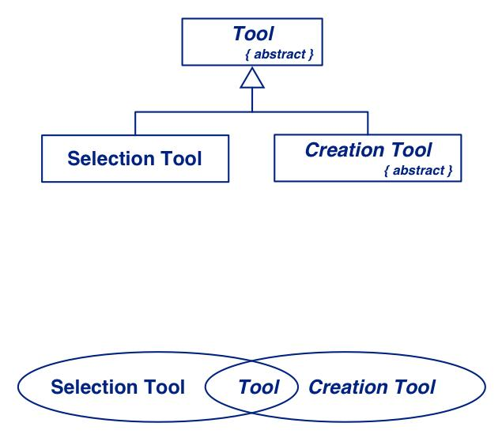
Sharing Responsibilities
Concrete classes may be both instantiated and inherited from.
Bad practice to subclass a concrete class, though!
Abstract classes may only be inherited from.
Venn Diagrams can be used to visualize shared responsibilities.
(Warning: not part of UML!)

Slide 29
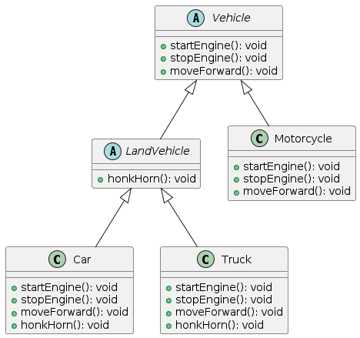
Building Good Hierarchies
Model a “kind-of” hierarchy:
Subclasses should/must support all inherited responsibilities, and possibly more.
Subclasses may refine/specialize an inherited responsibility, but should never hide a responsibility from a parent class.

Slide 30
Heuristics for Base Classes
Factor common responsibilities as high as possible:
Classes that share common responsibilities should inherit from a common abstract superclass; introduce any that are missing.

Slide 31
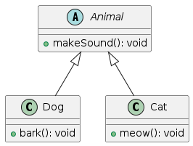
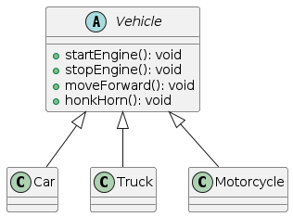
Heuristics for Base Classes
Factor common responsibilities as high as possible:
Heuristic 5.8 (p. 93)
Factor the commonality of data, behaviour and/or interface as high as possible in the inheritance hierarchy
Reduces the amount of classes where specific information is kept
Reduces maintenance overhead later on
But: may introduce complexity early on…

Slide 32
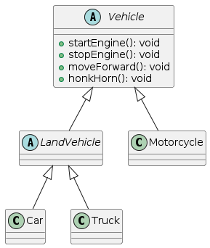
Building Good Hierarchies (cont.)
Make sure that abstract classes do not inherit from concrete classes:
Eliminate by introducing common abstract superclass: abstract classes should support responsibilities in an implementation-independent way

Slide 33
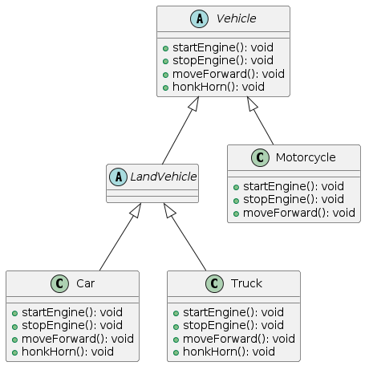
Building Good Hierarchies (cont.)
Eliminate classes that do not add functionality:
Classes should either add new responsibilities, or a particular way of implementing inherited ones

Slide 34
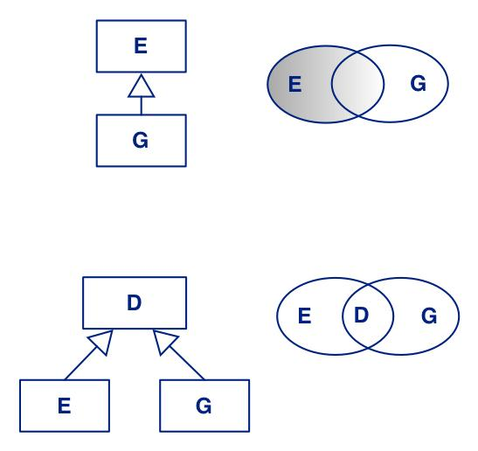
Building Kind-Of Hierarchies
Incorrect Subclass/Superclass Relationships
G assumes only some of the responsibilities inherited from E
Revised Inheritance Relationships
Introduce abstract superclasses to encapsulate common responsibilities

Slide 35
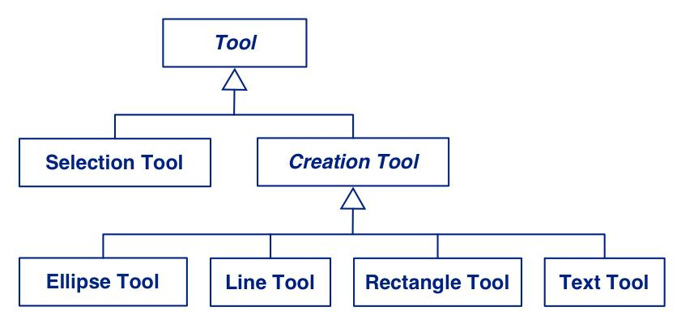
Graphics Editor - Tool Hierarchy
There is potential for additional shared behaviour
may need to be further considered…

Slide 36
Graphics Editor - Element Hierarchy
Drawing Element
*
Text Element
Line Element
Ellipse Element
Rectangle Element
Group Element
They all are drawn using one (or more) lines
common responsibility!

Slide 37
Element Hierarchy (cont.)
Including additional responsibility
Drawing Element
*
Text Element
Line Element
Ellipse Element
Rectangle Element
Group Element
Two classes do not have this additional responsibility!
Notes:
This approach (move “line capability to base class) violates Heuristic 5.1

Slide 38

Element Hierarchy (cont.)
Drawing Element
*
Text Element
Linear Element
Group Element
Line Element
Ellipse Element
Rectangle Element
Can be filled with colour
new responsibility!

Slide 39
Final Element Hierarchy
Drawing Element
*
Text Element
Linear Element
Group Element
Common design structure
more in Lecture 7
Line Element
Filled Element
Ellipse Element
Rectangle Element

Slide 40
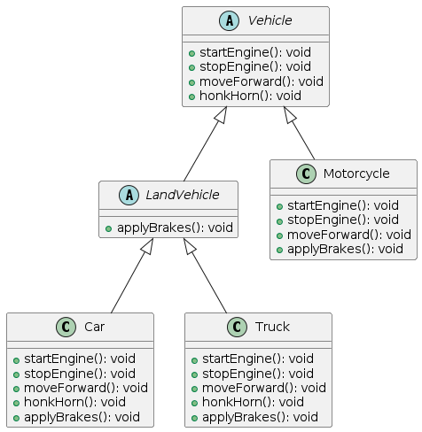
Inheritance Heuristics
Heuristic 5.4 (p. 84)
In theory, inheritance hierarchies should be deep - the deeper, the better
“Correct” set of responsibilities at each level.
Notes:
The deeper a hierarchy, the more complex it is, the harder it is to understand. Hence some trade-off between factoring out common responsibilities and understandability will have to be made…

Slide 41
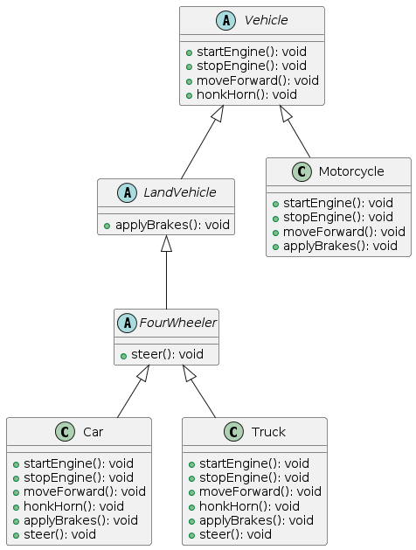
Inheritance Heuristics
Heuristic 5.5 (p. 84)
In practice, inheritance hierarchies should be no deeper than an average developer can keep in his/her short-term memory
Developers must be able to work with a given abstraction hierarchy! Assume 5 to 7 be a maximum depth.
Empirical studies show that hierarchies are rarely deep
Notes:
The deeper a hierarchy, the more complex it is, the harder it is to understand. Hence some trade-off between factoring out common responsibilities and understandability will have to be made…

Slide 42
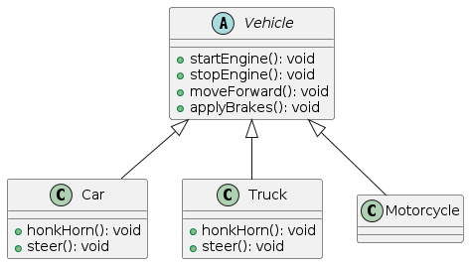
Inheritance Heuristics (cont.)
Heuristic 5.12 (p. 98)
Explicit case analysis on the type of an object is usually an error. The designer should use polymorphism in most cases
Case analysis also often reveals misassigned responsibilities!
Notes:
Explicit case analysis -> down casts
One could talk about the concept of “double dispatch” here…

Slide 43
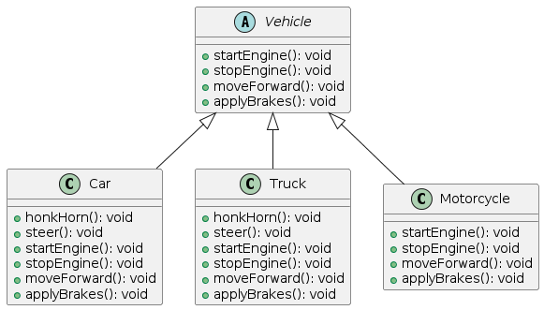
Inheritance Heuristics (cont.)
Heuristic 5.16 (p. 113)
It should be illegal for a derived class to override a base class method with a method that does nothing.
Declaring a NO-OP method implies that this class does not have a particular responsibility!
Notes:
Explicit case analysis -> down casts
One could talk about the concept of “double dispatch” here…

Slide 44
Break

Slide 45
Roadmap
Recap Lecture 5
Building good class hierarchies
Types of inheritance
Heuristics for creating class hierarchies
Roles and Protocols
Associations and Aggregations
Design by Contract

Slide 46
Roles and Protocols
Within an object-oriented application, objects collaborate to perform the desired/required responsibilities.
Collaborations are often described using protocols (interfaces and interaction sequences/dependencies)
Each participant in a collaboration plays a given role.
Roles can be either fixed or unbound.
Unbound roles can be used for tailoring an application (i.e. create a new class which can play this role).

Slide 47
Protocols and Roles (cont.)
Drawing Element is a class of the graphics editor;
it defines three roles:
Client: uses other elements of the application (i.e. other element classes; e.g. Line Element)
Child: can be contained in a Group Element
Subject: state being observed by other elements (e.g., Selection Tool)
Each of these roles implies
a number of related responsibilities
the usage of a particular collaboration protocol (e.g., a sequence of method invocations)
Drawing Element
Client
Child
Subject

Slide 48
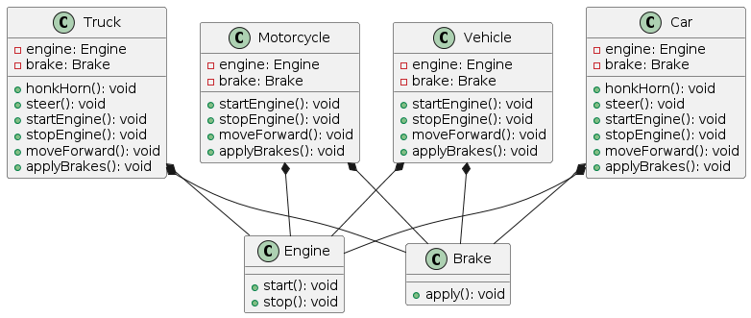
Interaction Heuristics
Heuristic 4.1 (p. 57)
Minimize the number of classes with which another class collaborates
Too many collaborators generally implies misassigned and/or incorrectly identified responsibilities

Slide 50
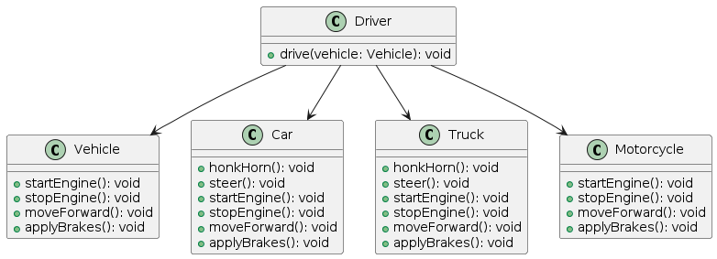
Interaction Heuristics
Heuristic 4.3 (p. 59)
Minimize the amount of collaboration between a class and its collaborator(s), that is, the number of messages sent
Implies that a collaboration protocol will have to be implemented using “few” methods
This can be quite problematic in some cases!

Slide 51
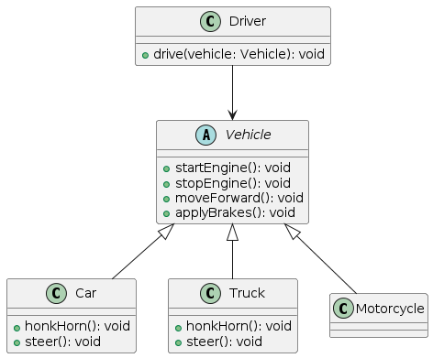

Slide 52
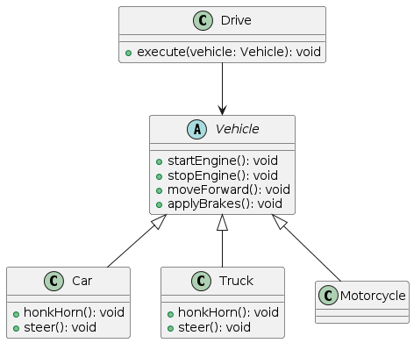
Interaction Heuristics (cont.)
Heuristic 3.9 (p. 43)
Do not turn an operation into a class
Be cautious when the name of a potential class is derived from a verb
However, there are situation when you do want operations to be encoded in a separate class!
For example, Strategies, Commands etc.
We will talk about those situations in the next lecture(s)…

Slide 54
Roadmap
Recap Lecture 5
Building good class hierarchies
Types of inheritance
Heuristics for creating class hierarchies
Roles and Protocols
Associations and Aggregations
Design by Contract

Slide 55
Associations and Aggregations
Drawing Element
*
Text Element
Linear Element
Group Element
A Group Element contains multiple Drawing Elements (in fact, instances of concrete subclasses thereof)
do we use aggregation or association to model this relationship?
what is the “best” way to represent associations and/or aggregations?

Slide 56
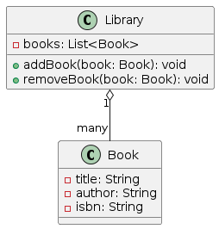
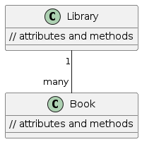
Heuristics for Associations
Heuristic 7.1 (p. 147)
When given a choice in an object-oriented design between a containment relationship and an association relationship, choose the containment relationship
Reduces the amount of exposure of internals of a class
However, one needs to be careful to decide when containment (aggregation) reflects the given model and when not (“life of objects” rule).
Notes:
I need to explain the “life of objects” rule here…

Slide 57
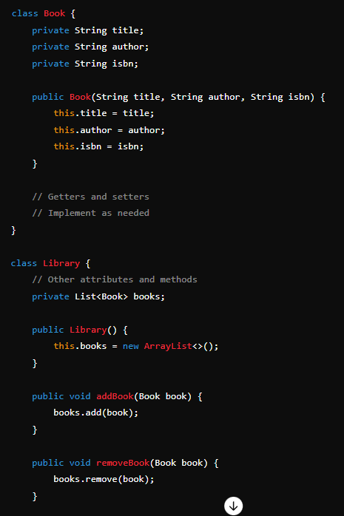
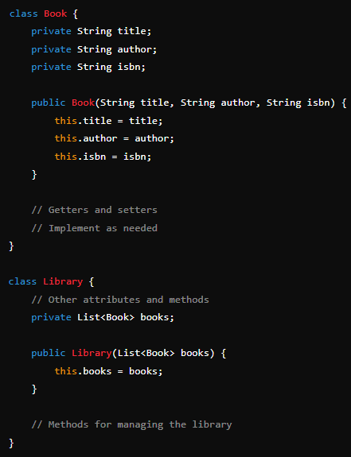

Slide 58
Associations and Aggregations (cont.)
Drawing Element
*
Text Element
Linear Element
Group Element
Clearly, the “children” of a Group Element can exist without its enclosing Group Element instance
we need to use association, not aggregation, to model this relationship!

Slide 59
Collections
The elements of an association/aggregation generally
need some form of expandable container/collection in the
corresponding enclosing object
But what kind of container/collection do we choose?
We need to be clear what kind of access we need for the elements of an association/aggregation!

Slide 60
Collections (cont.)
Only enumeration of elements needed
Choose the most general collection available
Want to avoid duplicates?
Choose a set-like collection
Need to be able to access specific elements?
Choose an “indexable” collection (e.g., Array, List, Hash)
Need a specific order in enumerations
Choose a collection that allows ordering of elements
Need some combination of the above?
Choose a collection that combines various behaviours
Most collection libraries provide various kinds of suitable classes
Notes:
I need to explain what I mean by “indexable”…
It may also be worth mentioning here that sometimes you do not really care about the order elements are enumerated, but that this order is consistent!

Slide 61
Roadmap
Recap Lecture 5
Building good class hierarchies
Types of inheritance
Heuristics for creating class hierarchies
Roles and Protocols
Associations and Aggregations
Design by Contract

Slide 62
Abstract State vs. Concrete State
Every object (bar a few rare exceptions) contains statefull information (an object has state).
Externally visible properties of this state defines its abstract state
Stack: size, order of elements, top element
Internal representations define the concrete state
Stack may use a list or array to “store” its elements
Clients should only ever rely on an object’s abstract state, not its concrete state.
Object equality should only ever be defined over the abstract, but not concrete state.
Notes:
I think I need to give an example or two to characterizes the difference between abstract and concrete state…

Slide 63
Command-Query Separation Principle
Divide all methods of a class into two, non-overlapping categories:
Queries
Return a result, but do not change the observable state of an object (that is, the method is free of observable side-effects)
The abstract state of an object remains invariant!
However, the concrete state may change (e.g., for caching)
Commands (aka modifiers)
Change the (abstract) state of an object, but do not return a value (other than termination)
(cf. http://martinfowler.com/bliki/CommandQuerySeparation.html)

Slide 64
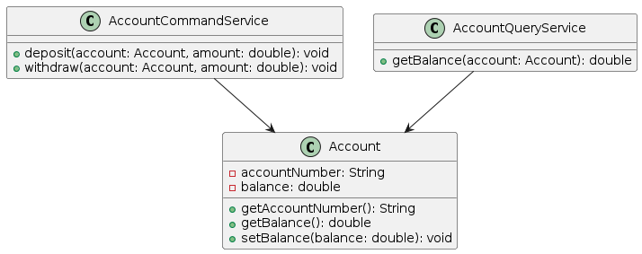
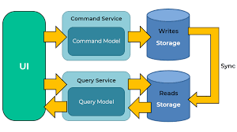

Slide 65
Design by Contract
A design concept introduced by Bertrand Meyer in the late 1980.
Key premise: view the relationship between a service provider (e.g., an object) and service consumer (e.g., a client of this object – possibly another object) as a formal agreement (or contract), specifying each party’s rights and obligations.
In practice: extend the definition of abstract data types (e.g., classes) with pre-conditions, post-conditions, invariants, and how these three concepts can be refined in subclasses.

Slide 66
Example - Stack Abstraction
deferred class STACK [G]
feature -- Element change
push (v : G) is -- Push v onto top
deferred
require
not_full: size <= max_size
ensure
item_pushed: top = v
size_increased: size = old size + 1
end;
pop is -- Remove top element
deferred
require
not_empty: size > 0
ensure
item_removed: size = old size - 1
not_full: size <= max_size
end;
top : G is -- Get top element
deferred
require
not_empty: size > 0
ensure
size_invariant: size = old size
end;
size : int is -- Get the size of the stack
deferred
end;
end -- class Stack
Preconditions
Postconditions

Slide 67
Design by Contract (cont.)
A service consumer must ensure that a service (method) on a provider is only ever invoked when this service’s pre-condition is met.
Pre-conditions must be expressed in terms of the public interface of a service!
If the pre-condition is not met, there is no obligation on the provider’s side to do anything “sensible”
A service provider must ensure that, after successful completion of a service, the service post-condition is met.
A service consumer can rely on the specified post-condition.
Any errors in the execution of a service must be flagged to the consumer!

Slide 68
Design by Contract (cont.)
Invariants of the service provider must hold after the successful execution of any of its externally visible services
During execution, they may be (obviously) violated…
Subclasses can only
Weaken pre-conditions to services
Strengthen post-conditions of services and/or invariants
Tools can assist in enforcing contracts and/or detect contract violations!
Notes:
Now I can talk about certain things about Eiffel!!!

Slide 69
Benefits of Design by Contract
Explicit notion of “contextualized” correctness
Enforces separation of concerns
Helps in assigning responsibilities to the “correct” class
Facilitates testing and debugging
There are even smart compilers that use it for optimizations!
Enhances documentation
As a consequence, facilitates reuse

Slide 70
Summary
Object-oriented decomposition is not a mechanical task
requires experience and a “bag full of best practices”
Heuristics and Principles give you a set of guidelines (only)
they do not define an algorithm for object design!
Apply (informed) common sense when you devise and restructure your design
common sense often leads to more comprehensible designs than any rules
Early verification helps in getting your design “right”

Slide 71
Question for Consideration
What is the Dependency Inversion Principle?
How does Design by Contract help create reliable software? What are the downsides to this methodology?
In regards to OO design, how can abstract classes be used to improve code re-usability and portability?
Explain the effect of including a 'God Class' in a system built under OOD guidelines. In what ways does it undermine and reduce the effectiveness of OO design and its goals?
What is the difference between an abstract class and an interface? When should you use an interface over an abstract class?
What is a vapor class and how do they contribute to the design of a system? Are there instances where they could be useful?

Slide 72
“Exercise” from Lecture 4
Develop a domain model for a chess game that allows a human player to play a game of chess against a computer.

Slide 73
Question to Answer
Consider the situation of designing a Chess application. Would you model a Queen to be a multiple heir of Rook and Bishop? If so, why? If not, why not and how would you model the commonalities of Queen, Rook and Bishop? Which heuristic(s) can help you in making a decision?
Notes:
NOTE: this is a question I have come up with myself…

Slide 74
Required Reading Lecture 7
Principal reading:
Douglas C. Schmidt, Michael Stal, Hans Rohnert and Frank Buschmann, Inside Patterns (available from Canvas)
Additional reading:
Frank Buschmann, Regine Meunier, Hans Rohnert, Peter Sommerlad, and Michael Stal, Pattern-Oriented Software Architecture: A System of Patterns, Chapter 1.
Erich Gamma, Richard Helm, Ralph Johnson, John Vlissides, Design Patterns, Chapter 1.
Various articles from Doug Schmidt's Patterns page: http://www.dre.vanderbilt.edu/~schmidt/patterns-frameworks.html

